Slide 1

Survey data analysis – week 14 Data integration
Peter Lugtig – p.lugtig@uu.nl
Notes:
Abstract

Slide 2
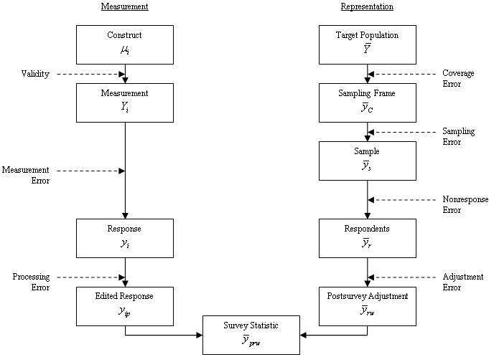
TSE is focused on error (accuracy + precision)
(Groves et al. 2009, p.48)
Notes:
Die Fehler erst nach und nach einblenden!!!!

Slide 3
Data quality framework of Biemer and Lyberg (2003)
Data of high quality has….
Credibility
Comparability
Interpretability
Accessibility
Relevance
Timeliness
Completeness
Accuracy
Coherence
Quality is “fitness for use”
Biemer, P. P., & Lyberg, L. E. (2003). Introduction to survey quality. John Wiley & Sons.

Slide 4
Data quality framework
The degree of confidence that users place in
data products based on their image of the data
provider.
Data of high quality has….
Credibility
Comparability
Interpretability
Accessibility
Relevance
Timeliness
Completeness
Accuracy
Coherence

Slide 5
Data quality framework
Data of high quality has….
Credibility
Comparability
Interpretability
Accessibility
Relevance
Timeliness
Completeness
Accuracy
Coherence

Slide 6
Data quality framework
There is clear data documentation (metadata) so that we understand what data is about
Data of high quality has….
Credibility
Comparability
Interpretability
Accessibility
Relevance
Timeliness
Completeness
Accuracy
Coherence

Slide 7
Data quality framework
Data of high quality has….
Credibility
Comparability
Interpretability
Accessibility
Relevance
Timeliness
Completeness
Accuracy
Coherence
The Netherlands HealthRI data access process

Slide 8
Data quality framework
Data of high quality has….
Credibility
Comparability
Interpretability
Accessibility
Relevance
Timeliness
Completeness
Accuracy
Coherence

Slide 9
Data quality framework
Data of high quality has….
Credibility
Comparability
Interpretability
Accessibility
Relevance
Timeliness
Completeness
Accuracy
Coherence
European Social Survey methodology overview

Slide 10
Data quality framework
Data of high quality has….
Credibility
Comparability
Interpretability
Accessibility
Relevance
Timeliness
Completeness
Accuracy
Coherence

Slide 11
Data quality framework
Data of high quality has….
Credibility
Comparability
Interpretability
Accessibility
Relevance
Timeliness
Completeness
Accuracy
Coherence

Slide 12
Data quality framework
Common definitions,classifications, and methodological standards (often over time)
Data of high quality has….
Credibility
Comparability
Interpretability
Accessibility
Relevance
Timeliness
Completeness
Accuracy
Coherence

Slide 13
What has changed in the big data landscape?
More sources
Administrative data
Survey data
Sensor data (phones, IoT)
Digital trace data
Organic (aka big) data
Non-prob surveys
Each with it’s own problems
Not one methodology for how to do data integration
Approach is always statistic-specific

Slide 14
The idea of data integration
Work around a shortcoming of one source with another one
Credibility
Comparability
Interpretability
Accessibility
Relevance
Timeliness
Completeness
Accuracy
Coherence
Multi-source statistics (de Waal, van Delden, Scholtus, 2020; or Zhang, 2012)

Slide 15
Multi-source statistics
4 dimensions
Units (sample, population)
Measurement (same, different)
Time dimension (same, different)
Level of aggregation (micro, or macro)
Can be combined
De Waal, T., van Delden, A., & Scholtus, S. (2020). Multi‐source statistics: basic situations and methods. International Statistical Review, 88(1), 203-228.

Slide 16
A lot of examples of data integration
Question with every application:
What quality dimension are we trying to improve?

Slide 17
Dimension 1: Multiple frames ( to cover population)
What quality dimension are we trying to improve?

Slide 18
Dimensions 1,2: same measurements, different units
Integrate smal probability based survey with
Larger non-probability one
Later guest lecture by Camilla Salvatore
What quality dimension are we trying to improve?

Slide 19
Dimensions 1,2: Same units, different measurements
Link 2 or more microdatasets of same individual
Data linkage (admin data)
Sampling frame information and survey data
Enriching surveys with administrative data
What quality dimension are we trying to improve?

Slide 20
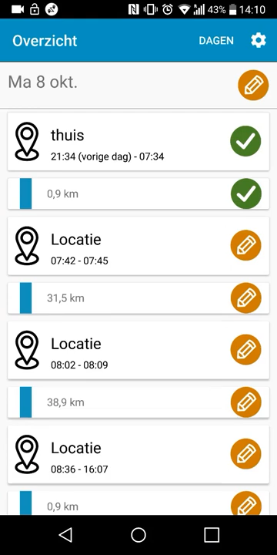
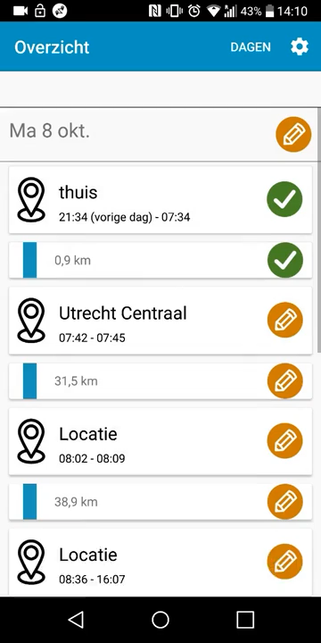
Dimensions 1,2: Same units, different measurements
Link 2 or more microdatasets of same individual
Designed big data
Lecture week 10

Slide 21
Dimension 2,3: measurement, time

Slide 22
Dimensions 2,4: Same measurement, different aggregation
Use microdata + same statistic at aggregate levels
Use population statistics for weighting/calibration
Validate and asses accuracy of survey data
E.g. Sensitive questions

Slide 23
Dimensions 3,4: different periods, different levels of aggregation
Use national survey data with local administrative data to make predictions at local level
Small area estimation

Slide 24
Data Integration and nonprobability samples: Key concepts
DATA INTEGRATION
Camilla Salvatore
c.salvatore@uu.nl

Slide 25
Revising key concepts: Probability vs nonprobability samples
Probability samples (PS) Allow inferences to the general population
Non-Probability samples (NPS) Drawing inference is hard or not possible
Can you think about some good characteristics and statistical issues?
Can you think about some good characteristics and statistical issues?

Slide 26
Revising key concepts: Probability vs nonprobability samples
Probability samples (PS) Allow inferences to the general population
Non-Probability samples (NPS) Drawing inference is hard or not possible
High data quality
Rely on sampling theory
Design/Model based inference
Falling response rate, time-consuming, expensive
More affordable, timely, convenient, new aspects of phenomena
No unified inferential framework
Unknown selection mechanism:
Self-selection → selection bias (SB)
Diverse: NPS surveys, digital traces
Integrating PS and NPS data (Salvatore, 2023; Rao, 2021; Cornesse et al., 2020):
Improve inference reducing also the costs of analysis
Study new aspects not measured by traditional surveys

Slide 27
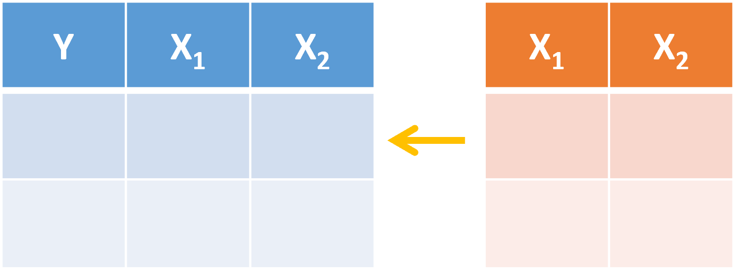
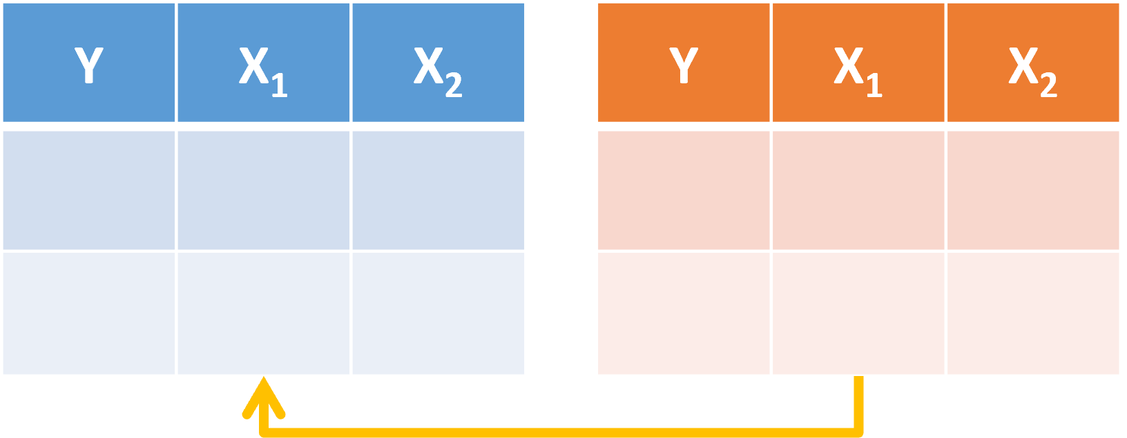
Revising key concepts: Probability vs nonprobability samples
Comparing PS and NPS estimates (Pasek, 2016):
Finite population estimates tend to be more dissimilar than correlations and regression coefficients
No consensus about whether and in which cases differences will be notable
Two inferential approaches (Rao, 2020):
Adjusting for SB with auxiliary data Blending PS and NPS

Slide 28
Two principles of Data Integration (DI)
Any ideas? Insights from previous lectures/discussions?

Slide 29
Two principles of Data Integration (DI)
1. DI is statistics and purpose specific
How do we integrate data?
Finite population and analytic inference
Structured and unstructured data
Composite indicators
Variables are available in all sources or only in some
One source is used as a supplement or to correct for selection bias
Combining different sources to improve measurement

Slide 30
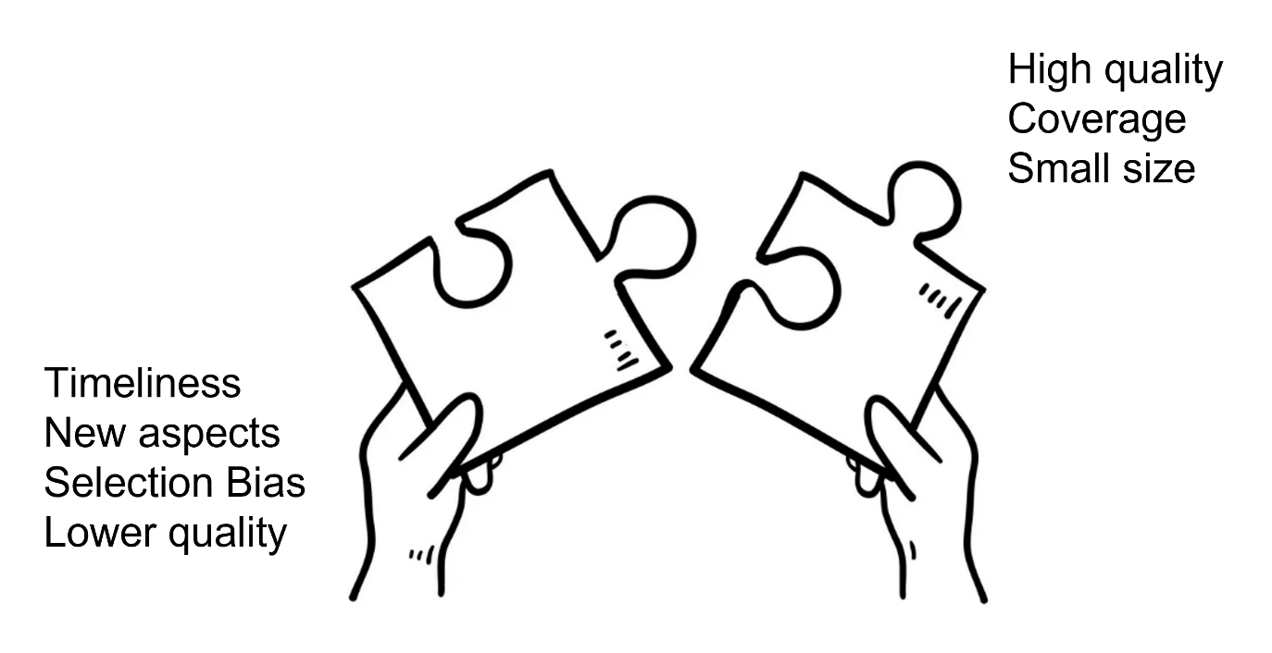
Two principles of Data Integration (DI)
1. DI is statistics and purpose specific
How do we integrate data?
2. DI is a puzzle
Why data integration?
Finite population and analytic inference
Structured and unstructured data
Composite indicators
Variables are available in all sources or only in some
One source is used as a supplement or to correct for selection bias
Combining different sources to improve measurement

Slide 31
Enhancing analytic inference while reducing the costs: a Bayesian data integration approach
DATA INTEGRATION
Camilla Salvatore
c.salvatore@uu.nl

Slide 32

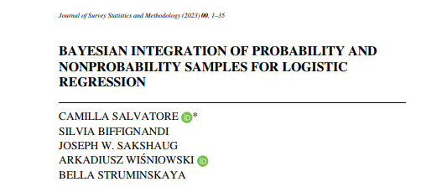
The research paper
https://doi.org/10.1093/jssam/smad041

Slide 33
The context
Problem
A researcher is interested in making inferences from a PS survey but cannot afford a large sample size

Slide 34
The context
Problem
A researcher is interested in making inferences from a PS survey but cannot afford a large sample size
Alternatives
Reduce the sample size: small PS → large variance but theoretically unbiased estimates
Opt for a NPS: bias but low variance

Slide 35
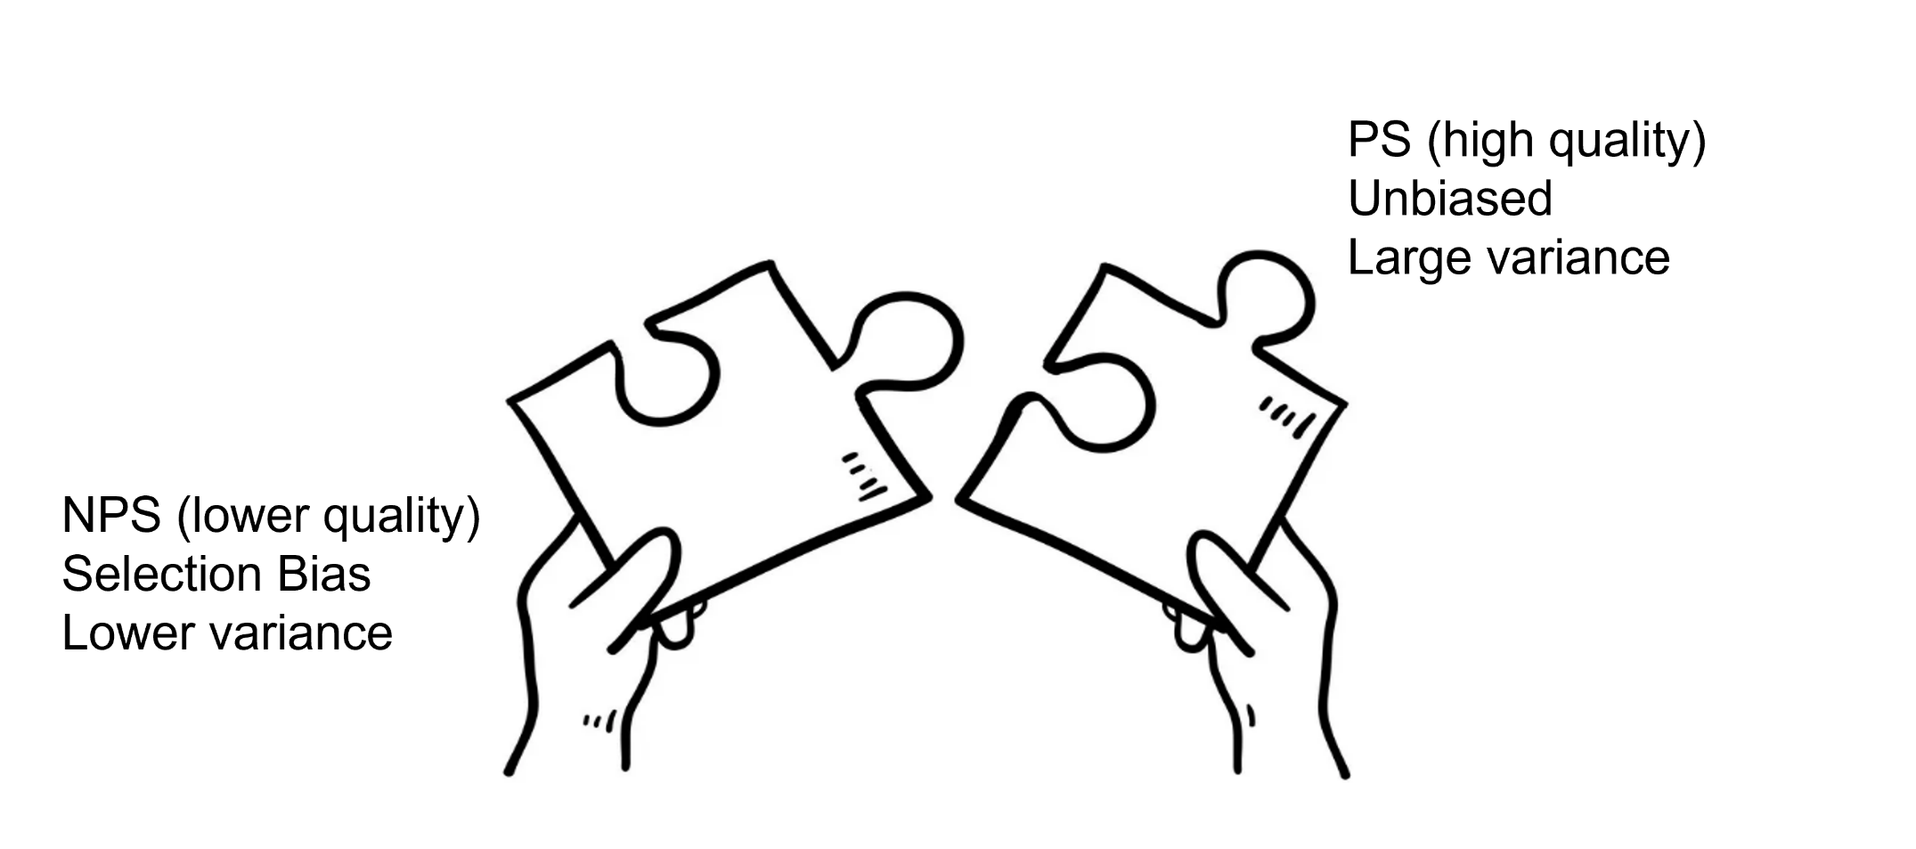
Our proposal
The data integration puzzle

Slide 36
Our proposal
The data integration puzzle
Small size to reduce costs

Slide 37
Our proposal
The data integration perspective
Integrate small PS + larger NPS
to improve inference on logistic regression coefficients
under the Bayesian framework
reducing survey costs
Inference
Based on small PS data (unbiased, high variance)
Incorporation of biased NPS data into the estimation process (low variance)
Posterior estimates are likely to have more bias than PS estimates but possibly less variance (bias/var trade off)

Slide 38
Two aims
Enhance inference (MSE)
Baseline situation: analysis of small PS only (gold standard)
Data Integration: can we reduce MSE with respect to the baseline situation?
Reduce survey costs
Can we obtain at a lower cost the same MSE that we would obtain analyzing a much larger and costly PS only survey?
4

Slide 39
Two aims
Selection scenarios & level of SB
Outcome variables
PS and NPS sizes
Enhance inference (MSE) → Simulation & Real Data Analysis →
Baseline situation: analysis of small PS only (gold standard)
Data Integration: can we reduce MSE with respect to the baseline situation?
Reduce survey costs → Cost Analysis → Interactive Shiny App
Can we obtain at a lower cost the same MSE that we would obtain analyzing a much larger and costly PS only survey?
4

Slide 40

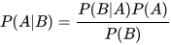
What is Bayesian statistics?
Thomas Bayes
Bayes’ theorem

Slide 41
What is Bayesian statistics?
Some differences with the frequentist approach
Bayesian: parameters are random variables
Frequentist: parameters are non-random. Randomness is introduced by sampling
In Bayesian statistics prior belief play a fundamental role (subjective approach):
We start with a prior belief (prior to looking at the data) and we update it using the data → we obtain the posterior

Slide 42
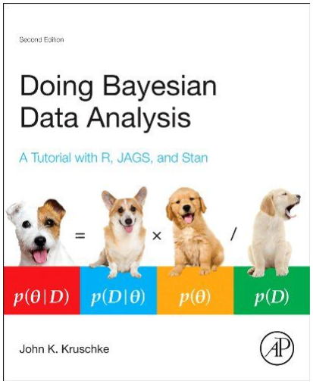
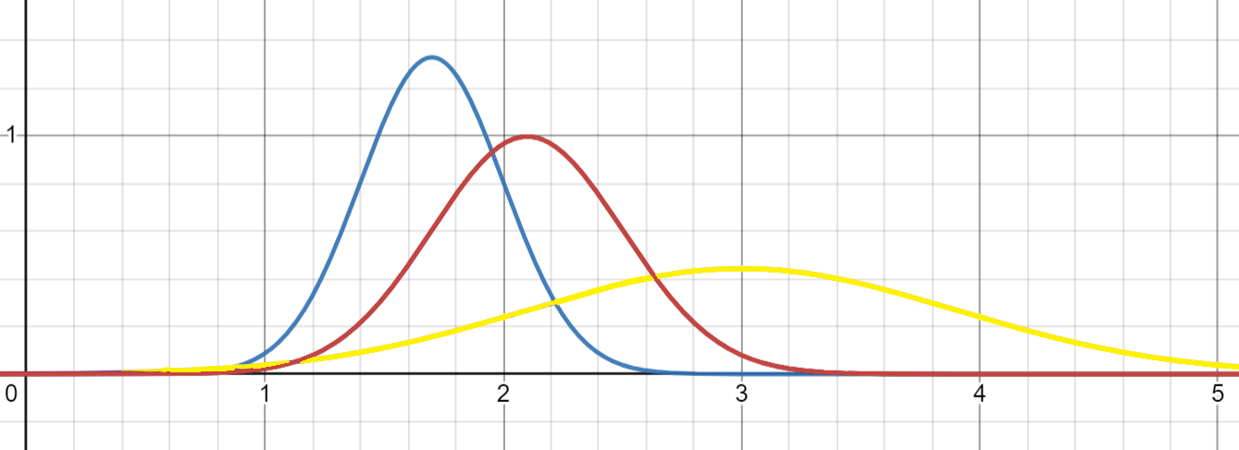

What is Bayesian statistics?
$$p\left(θ|x\right)=p\left(D|x\right) ×p\left(θ\right)/p\left(D\right)$$
Posterior Likelihood Prior Marginal
$$p\left(θ|x\right)∝p\left(D|x\right) ×p\left(θ\right)$$

Slide 43

Why Bayesian? (Kruschke, 2014; Gelman et al., 2013)
Natural choice to integrate data with varying levels of quality
Its structure can be exploited in order to incentivize high-quality data
$$p\left(θ|x\right)∝p\left(D|x\right) ×p\left(θ\right)$$

Slide 44

Why Bayesian? (Kruschke, 2014; Gelman et al., 2013)
Natural choice to integrate data with varying levels of quality
Its structure can be exploited in order to incentivize high-quality data
$$p\left(θ|x\right)∝p\left(D|x\right) ×p\left(θ\right)$$
The prior is based on NPS. How much it should influence the inference?
We borrow information based on the similarity between PS and NPS

Slide 45
Research structure
Background: Sakshaug et al (2019) and Wisniowski et al. (2020) papers (Continuous outcome variable)
Part I – Simulation study (100 repetitions)
Different selection scenarios, prior specifications, PS and NPS sizes
Evaluate the performance of several informative priors against a PS-ONLY one in terms of MSE
Part II – Real data analysis
American Trend Panel + 9 parallel NPS surveys
Shiny app with interactive cost analysis

Slide 46
Priors
PS-ONLY (No data integration)
A weakly informative prior proposed by Gelman et al. (2008)
Control prior against which compare data integration results

Slide 47
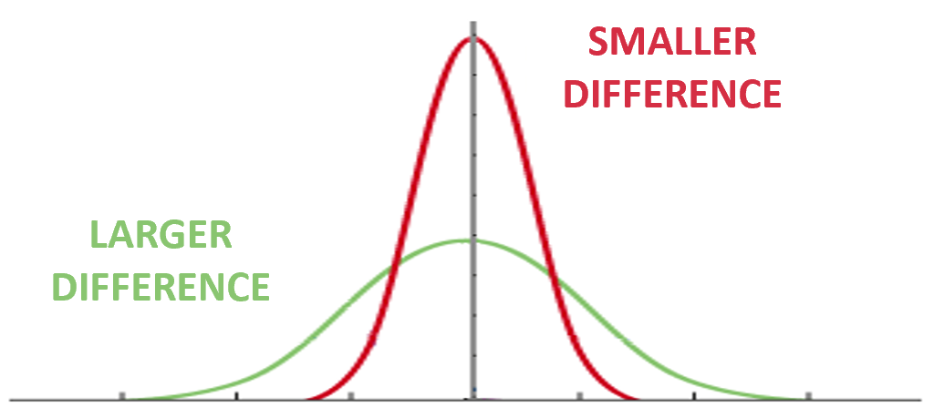
Informative priors: integrating PS and NPS data
Distances priors: The influence of the prior depends on the difference between ML estimates
The Basic distance prior
$$β_{j}∼𝒩\left(\hat{β_{NP}},\left|\hat{β_{P}}−\hat{β_{NP}}\right|\right)$$

Slide 48
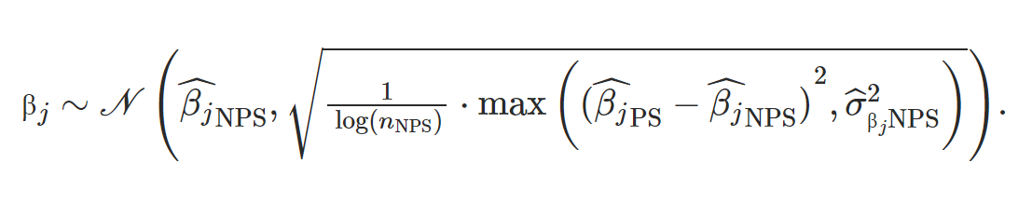
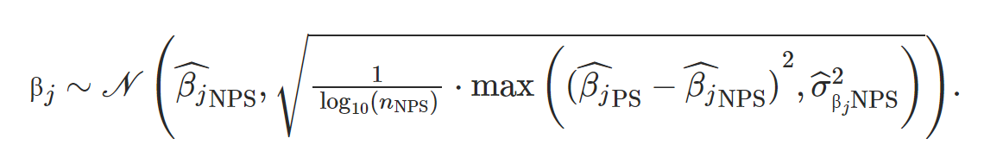
Informative priors: integrating PS and NPS data
Distances priors: The influence of the prior depends on the difference between ML estimates
The Distance Log Prior
The Distance Log 10 Prior (wider distribution)
Mixed distance priors: Baseline prior for $β_{0}$ and distances priors for other coefficients

Slide 49
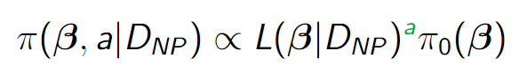

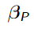
Informative priors: integrating PS and NPS data
Power prior (Ibrahim et al., 2000)
How much do we borrow from NPS?
The power parameter “a”:
1 = full borrowing
0 = no borrowing
We select it dynamically based on the similarity between PS and NPS
We are working on different measures but for now:
It is the p-value of the Hotelling t-test for the difference between and )
Power prior
Likelihood NPS
Baseline prior
Likelihood NPS
a ≈ 1
High borrowing
a ≈ 0 Low borrowing
8

Slide 50
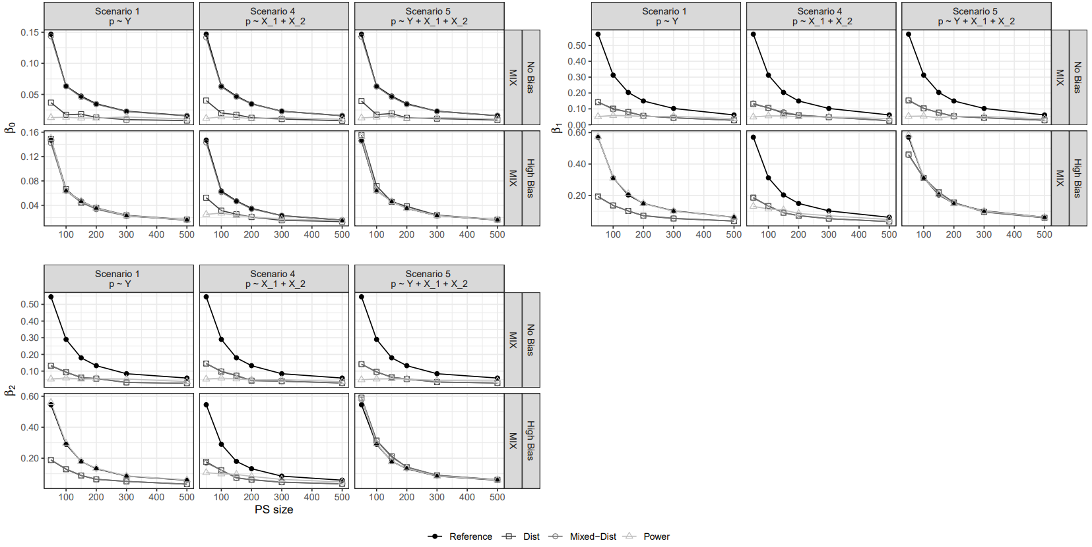
Results: selected cases – Beta1

Slide 51
Results: selected cases
Median MSE across 100 repetitions:
Worst case-scenario: INF prior perform similarly to PS-only prior (bias protection mechanism)
Low SB and small PS: large improvements in MSE

Slide 52
Application: the data
PS data – American Trends Panel (ATP)
Pew Research Center’s nationally representative online survey panel
Sample size: 3000 units → PS ∈ (50, 100, 150, 200, 500)
NPS data - 9 parallel online NPS from different vendors
Vendors implemented quota sampling with different quota variables (demographic vs webographic)
Sample size of about 1000 respondents
Outcome variables: Smoking, Always vote, Neighborhood Trust, Neighborhood Safety, Healthcare coverage, Volunteering
Covariates: Age, gender, education, survey weight

Slide 53
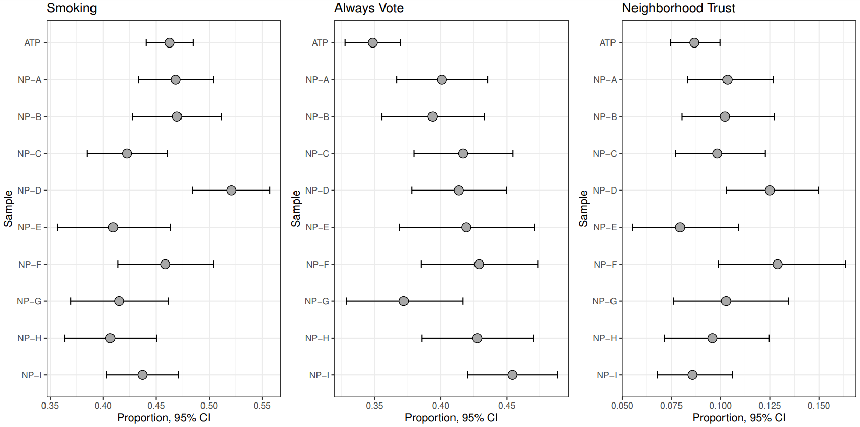
Comparing proportions

Slide 54
Comparing proportions

Slide 55
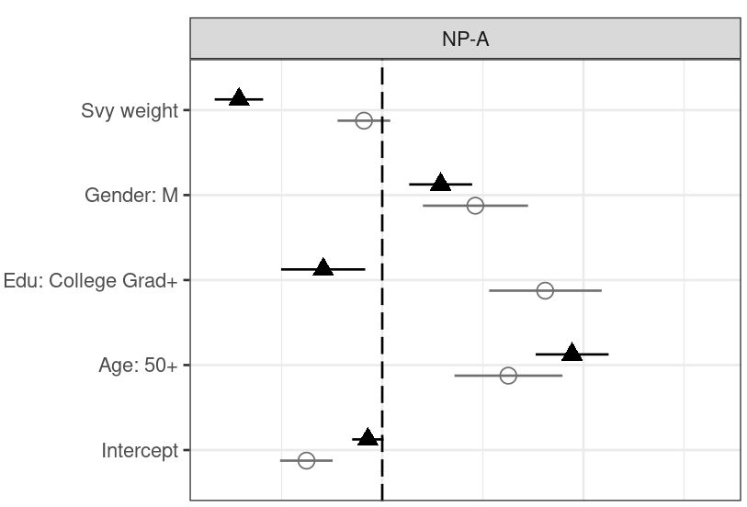
Comparing coefficients: an example with Always vote

Slide 56
Comparing coefficients: an example with Always vote

Slide 57
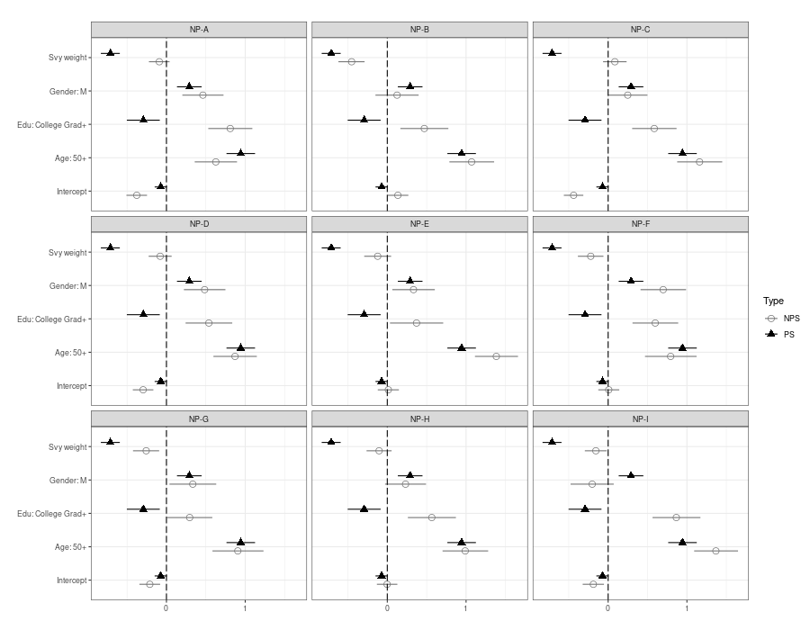
Comparing coefficients: an example with Always vote

Slide 58
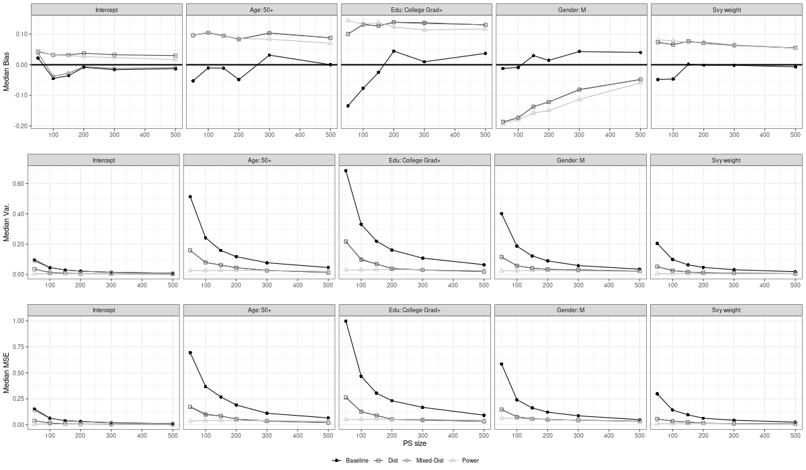
Reduction in MSE is driven by a reduction in the variability
Results: an example with Smoking

Slide 59
Reduction in MSE is driven by a reduction in the variability
Results: an example with Smoking

Slide 60

Cost Analysis
Results
PS costs ≥ 3 times NPS costs: best performing INF priors yield significant cost savings ≈ 70%
PS costs = 2 times NPS costs: cost savings are marginal or negative
Interactive Analysis: Shiny App
https://bayesdataintegration.shinyapps.io/shiny_bayes_data_integration/

Slide 61
Take aways
Survey researchers face budgetary and time constraints → fielding large size PS is difficult
Small PS yield large variances for survey estimates
Our approach offers a practical solution to improve analytic inference (reduced variances and MSEs) while lowering survey costs
Shiny App: facilitate researchers interested in designing and integrating parallel PS and NPS
Some thoughts:
Do you think integrating various data types will become crucial for surveys research (& Official Stat.)?
What do you think about integrating surveys and digital trace (big) data?

Slide 62
Group exercise (40 min)
25 min group work + 5 min discussion per group
6 groups:
Group 1: Smoking
Group 2: Always vote
Group 3: Volunteering
Group 4: Neighborhood Safety
Group 5: Healthcare coverage
Group 6: Neighborhood Trust
Shortly present your findings to others
Points of discussion in the next slides (you can decide to address them all or only the most relevant for your case)

Slide 63
Group exercise (40 min)
Open the Shiny App and go to Real Data Analysis
In Data/Additional plots look at the variables of interest:
Are there differences across NPS? Which NPS do you think is better?
Are PS and NPS estimates similar?
In Data/Results look at the variables of interest:
Is there a bias/variance trade off?
Are there differences across NPS? Which NPS you think is better?
Which prior works better and under which conditions (ex. PS or NPS size)?
In Data/Cost Analysis/Max savings look at the variables of interest (use the search tool)
Which is the best NPS in terms of savings if the PS cost is 6 times the NPS cost (the default in the app)?
Does the result change according to the PS size?

Slide 64
References
Salvatore, C., Biffignandi, S., Sakshaug, J. W., Wiśniowski, A., & Struminskaya, B. (2023). Bayesian Integration of Probability and Nonprobability Samples for Logistic Regression. Journal of Survey Statistics and Methodology, https://doi.org/10.1093/jssam/smad041
Salvatore, C. (2023). Inference with non-probability samples and survey data integration: a science mapping study. Metron, 1-25. https://doi.org/10.1007/s40300-023-00243-6
Sakshaug, J. W., Wiśniowski, A., Ruiz, D. A. P., & Blom, A. G. (2019). Supplementing small probability samples with nonprobability samples: A Bayesian approach. Journal of Official Statistics, 35(3), 653-681.
Wiśniowski, A., Sakshaug, J. W., Perez Ruiz, D. A., & Blom, A. G. (2020). Integrating probability and nonprobability samples for survey inference. Journal of Survey Statistics and Methodology, 8(1), 120-147.
Cornesse, C., Blom, A. G., Dutwin, D., Krosnick, J. A., De Leeuw, E. D., Legleye, S., ... & Wenz, A. (2020). A review of conceptual approaches and empirical evidence on probability and nonprobability sample survey research. Journal of Survey Statistics and Methodology, 8(1), 4-36.
Beaumont, J. F., & Rao, J. N. K. (2021). Pitfalls of making inferences from non-probability samples: Can data integration through probability samples provide remedies? Surv. Stat, 83, 11-22.
Rao, J. N. K. (2021). On making valid inferences by integrating data from surveys and other sources. Sankhya B, 83, 242-272.
Pasek, J. (2016). When will nonprobability surveys mirror probability surveys? Considering types of inference and weighting strategies as criteria for correspondence. International Journal of Public Opinion Research, 28(2), 269-291.
Ibrahim, J. G., & Chen, M. H. (2000). Power prior distributions for regression models. Statistical Science, 46-60.

Slide 65
References
Biemer, P. P., & Lyberg, L. E. (2003). Introduction to survey quality. John Wiley & Sons.
De Waal, T., van Delden, A., & Scholtus, S. (2020). Multi‐source statistics: basic situations and methods. International Statistical Review, 88(1), 203-228.
llic, G., Schouten, J.G., Lugtig, P., Mulder, J., Streefkerk, M., Kumar, and P. Höcük, S. (2022). Pictures instead of survey questions: An experimental investigation of the feasibility of using pictures in a housing survey. JRSS:A.
McCool, D., Schouten, J.G. & Lugtig, P. (2021). An app-assisted travel survey in official statistics. Possibilities and challenges. Journal of Official Statistics
van Delden, A., Scholtus, S., de Waal, T., & Csorba, I. (2023). Methods for estimating the quality of multisource statistics. Advances in Business Statistics, Methods and Data Collection, 781-804.
Wiśniowski, A., Sakshaug, J. W., Perez Ruiz, D. A., & Blom, A. G. (2020). Integrating probability and nonprobability samples for survey inference. Journal of Survey Statistics and Methodology, 8(1), 120-147.

